Slide 1


A Beginner’s Guide to Web Components
steve.fabian@gooddogs.com @SteveFabian

Slide 2

Web Components
Agenda
What is it?
What does it do?
How do I use it?

Slide 3
Web Components
What is it?
Web Components are a set of standards that allow for the creation of reusable widgets or components in web documents and web applications.
-- Wikipedia

Slide 4
Web Components
What does it do?
- Encapsulates HTML, CSS and JS into custom HTML elements

Slide 5
Web Components
How does it do that!!?
- Uses Shadow-DOM to isolate element markup and resources from host DOM

Slide 6
Web Components
What is Shadow DOM?
- A DOM (Document Object Model) is a tree of nodes - Shadow DOM provides ‘functional encapsulation’
- Eg: the ‘video’ node is a collection of sub-nodes (html elements, buttons, labels, etc). Those sub-nodes are defined in the Shadow DOM
- Each node in the ‘Light’ DOM can host one or more Shadow DOM subtrees

Slide 7
Web Components
What is Shadow DOM?
- When a web page is rendered, and a node that hosts a Shadow DOM is found, the Shadow DOM nodes are rendered ‘instead’ of the host node. - eg: <button>Hello, world!</button> <script> var host = document.querySelector('button'); var root = host.createShadowRoot(); root.textContent = ‘Goodbye'; </script>
button will be rendered with ”Goodbye” as the text

Slide 8
Web Components
What is the Problem we’re trying to address… - to render a ‘name tag’ div on a page, the old way would be to define .css stylesheet with all the classes, include the stylesheet with a <link> tag, then code each element of the div into the ‘Light’ DOM <link rel=“stylesheet” href=“css/style.css” /> <div class=“wrapper">
<div class=“header"> Hi! My name is </div>
<div class=“name"> Bob
</div>
</div>
If some other .css class styles conflict with yours the layout will be affected.

Slide 9
Web Components
How does Shadow DOM help? - Use the Shadow DOM to define the HTML markup and css styles, then simply use the ‘Light’ node as a host for the Shadow DOM nodes that make up the name tag
There’s a boundary between Light and Shadow DOMs, so changes to styles in the Light DOM do not affect nodes in the Shadow DOM.

Slide 10
Web Components
<div id="nameTag">Bob</div>
<script>
var shadow = document.querySelector('#nameTag').createShadowRoot();
var template = document.querySelector('#nameTagTemplate');
var shadowNode = document.importNode(template.content, true);
shadow.appendChild(shadowNode);
</script> <template id="nameTagTemplate">
<style> .wrapper{ border: 2px solid brown; header: color: red; .. etc ..</style>
<div class=“wrapper">
<div class=“header"> Hi! My name is </div>
<div class="name"> Bob </div>
</div>
</template>

Slide 11
Web Components
How do I get started?
- Use JS to create/insert/modify Shadow-DOM element
- Polymer.js (recommended option)
- Polyfills def: a polyfill (or polyfiller) is downloadable code which provides facilities that are not built into a web browser.

Slide 12
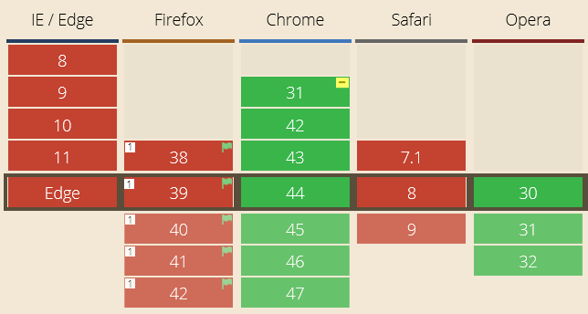
Web Components
Polymer Native Brower support?

Slide 13
Web Components
How do I use it?
Let’s write some code... !
Demos

Slide 14
Web Components
Resources
https://www.polymer-project.org/1.0/
https://gist.github.com/ebidel/6314025 http://github.com/SteveFabian
Steve Fabian e: steve.fabian@gooddogs.com
@SteveFabian

